Slide 1

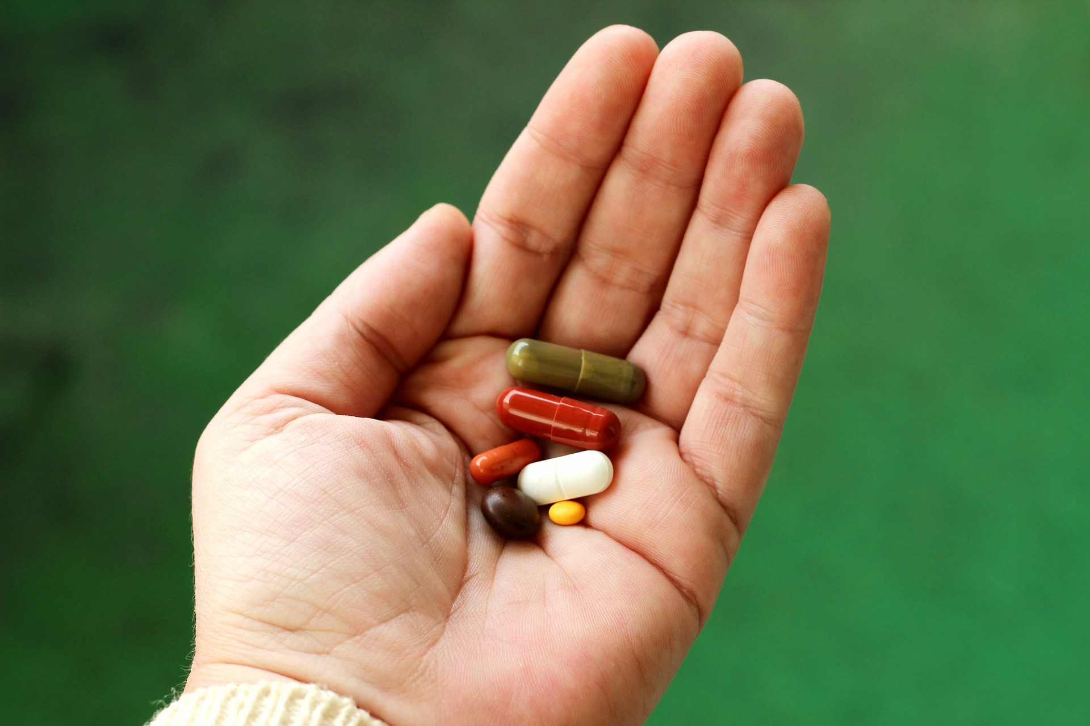
Medictionary
Jeongyun Lee
Ronnel Mattew
Eyad Al Hafi
Marc Visa
Notes:
Main page :

Slide 2

Index
1st Sprint
01 >>
1st sprint plan
02 >>
Requirements
03 >>
Use Cases & User stories
04 >>
General Architecture
05 >>
Database Model
06 >>
Financial Architecture
07 >>
Mock up & Prototype App

Slide 3

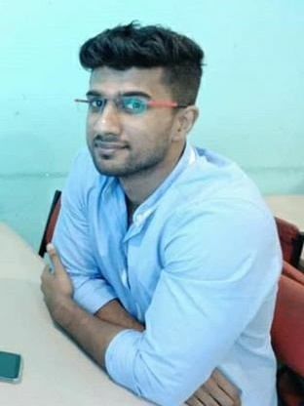


Team Members
Jeongyun Lee
Ronnel Mattew
Marc Visa
Eyad Al Hafi
Scrum Master
Financial Expert
General Expert
Developer
00 Team Members

Slide 4
01. Sprint Planning
- Installing program, frameworks (1)
Studying frameworks (2)
Simple sign up, log in, log out (7.5)
Start menu with the logo of the app (2.5)
DEVOPMENT
Searching engine (6.5)
+ Sprint meeting minutes (1.5)
+ Github management (2)
+ Sprint Explanation (2)
- UI Mockup (6)
Scrum
Managing
Drawing the charts and diagrams (3)
Design
Financial factors (8)
Data Structure (6.5)
+ General System Structure (2.5)
+ User story, User cases (6)
00 Team Members
01 Sprint Planning

Slide 5


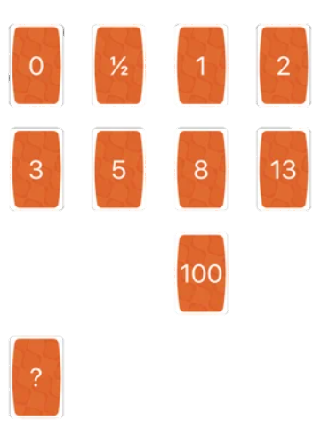







01. Sprint Planning
Experience
Speciality
Proficiency
00 Team Members
01 Sprint Planning

Slide 6






02. Requirements PBI
Function 0
Sign up & Sign in
Function 2
Alarm & Pillbox
Scrum &
Project Managing
Sign up , Sign in with username / pw
Sign up, sign in with Google Account
Sign up, Sign in with Facebook Account
Setting Alarm
Pillbox
Sprint meeting minutes
Presentation resource
Sprint explanation
General Architecture
Financial Architecture
Mock Up
Function 1
Searching Pill
Function 3
Notification
Backend
Start menu
Searching bar with name / characteristic
List up page
Pill description page
Pop-up Notification
Notification scenario
Alternative DB resource
DB data model
Building the DB
00 Team Members
01 Sprint Planning
02 Requirements

Slide 7
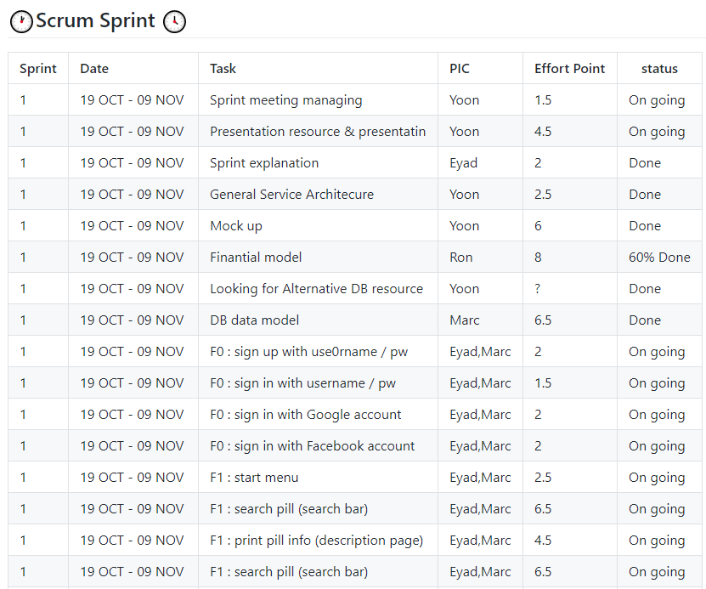
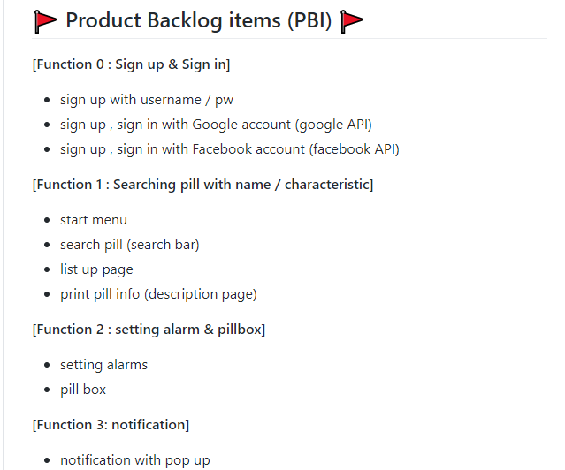
02. Requirements
Product Backlog Items
Sprint backlog tasks
https://github.com/jy-977/ICT-medictionary
https://github.com/jy-977/ICT-medictionary
00 Team Members
01 Sprint Planning
02 Requirements

Slide 8
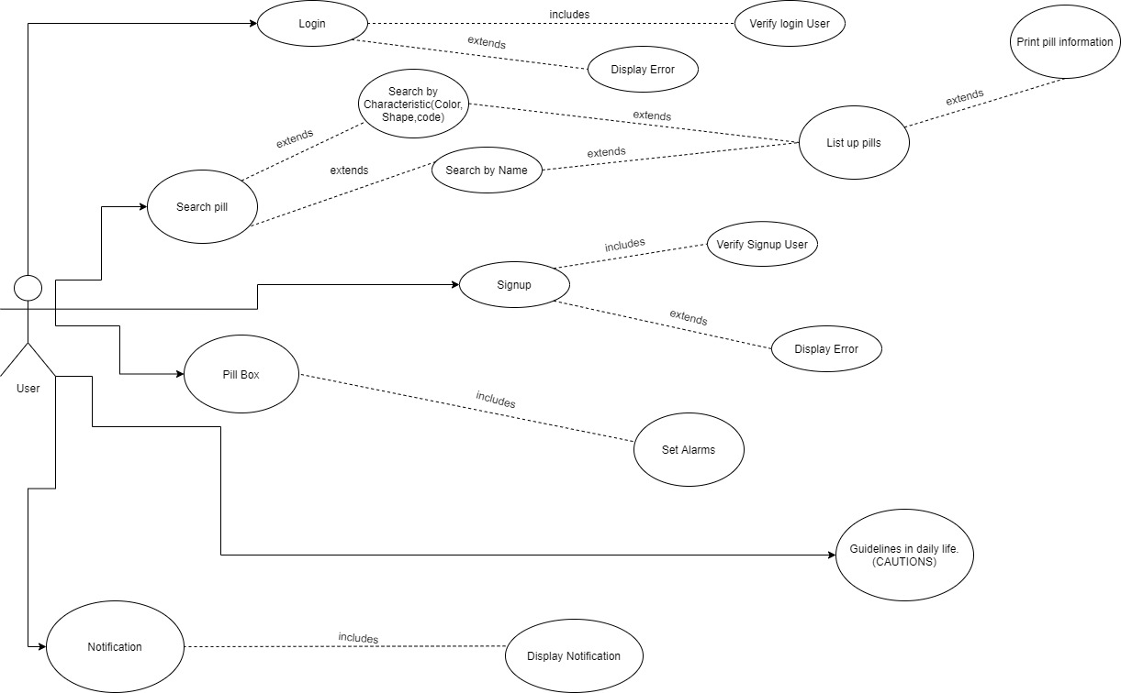
03. Use cases & User stories
Use Case Scenario
Sign up
The User would be able to sign up in the application.
Sign in page : the user is verified
Display error : fail to be verified
Log in
User will be able to log in to application in this use case
Display error : fail to log in
Search Pill
The user can access to all the available information.
This use case include Search By Characteristics, Search
By Name, Print info cases
The user can access to all the medicines they are taking. Moreover, They can Set alarms based on the pills of pill box
Pill box
The user can access to all the medicines they are taking. Moreover, They can Set alarms based on the pills of pill box
Pill box
Notification
The user can be warned when they have the medicines
with conflicted ingredients and would get cautions for diet.
00 Team Members
01 Sprint Planning
02 Requirements
03 User cases & User stories

Slide 9
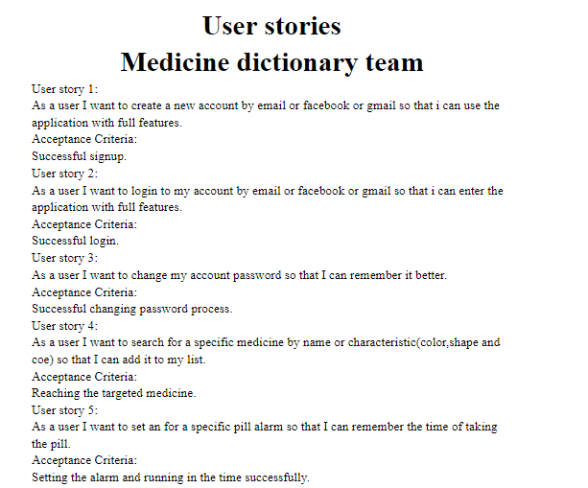
03. Use cases & User stories
User Stories
User Stories
User story
Want to see more?
Acceptance criteria
https://docs.google.com/document/d/178I4GFFEglWldp21qo7pgHYZH8e5FPbbvAqB-eMqFPQ/edit?usp=sharing
User story
Acceptance criteria
User story
Acceptance criteria
User story
Acceptance criteria
User story
Acceptance criteria
00 Team Members
01 Sprint Planning
02 Requirements
03 User cases & User stories
Notes:
Marc,
you don’t’ need to explain everything. Just show them we did Userstories, and Uscases both.
Basically the contents of Users stories are same with Use cases.
So you can just read 1 or 2 cases of user story and acceptance criteria, and you can just say,
We don’t have much time, so if you want to se more details of Userstory, you can access with this link ( right side) or github easily.

Slide 10
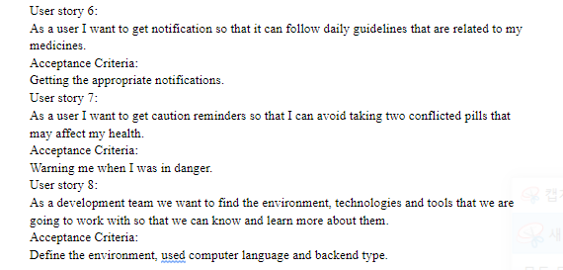
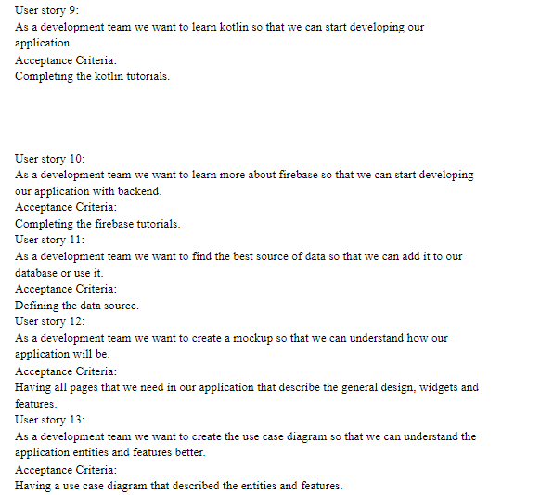
03. Use cases & User stories
User story
User Stories
User Stories
Acceptance criteria
User story
Want to see more?
Acceptance criteria
https://docs.google.com/document/d/178I4GFFEglWldp21qo7pgHYZH8e5FPbbvAqB-eMqFPQ/edit?usp=sharing
User story
Acceptance criteria
User story
Acceptance criteria
User story
Acceptance criteria
User story
Acceptance criteria
00 Team Members
01 Sprint Planning
02 Requirements
03 User cases & User stories

Slide 11
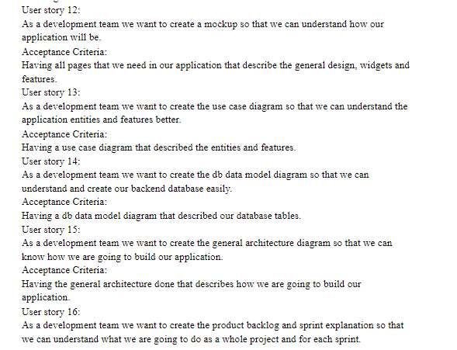
03. Use cases & User stories
User story
User Stories
User Stories
Acceptance criteria
User story
Want to see more?
Acceptance criteria
https://docs.google.com/document/d/178I4GFFEglWldp21qo7pgHYZH8e5FPbbvAqB-eMqFPQ/edit?usp=sharing
User story
Acceptance criteria
User story
Acceptance criteria
User story
Acceptance criteria
00 Team Members
01 Sprint Planning
02 Requirements
03 User cases & User stories
Notes:
Marc,
you don’t’ need to explain everything. Just show them we did Userstories, and Uscases both.
Basically the contents of Users stories are same with Use cases.
So you can just read 1 or 2 cases of user story and acceptance criteria, and you can just say,
We don’t have much time, so if you want to se more details of Userstory, you can access with this link ( right side) or github easily.

Slide 12





04. General Architecture
Front - end
Request
Back-end
Searching conditions
Response
External database
Searching result, description
00 Team Members
01 Sprint Planning
02 Requirements
03 User cases & User stories
04 General Architecture
Notes:
We can mention about our issue about external databases.
We tired to use CIMA database which is presented by Spainish government.
But there are no elements we need so We found another Database api.
We are checking that there are compulsory elements in new DB.

Slide 13
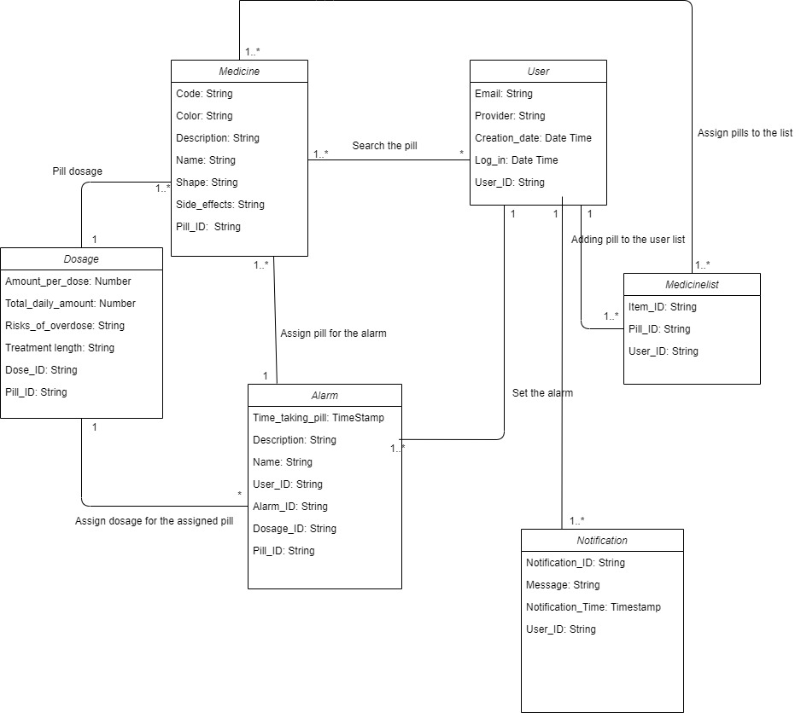
05. Database Model
Entities
For searching function : the code, shape, color and name
For delivering the information: description and side effects
For the data management : Pill_ID (primary key)
Medicine
User
For authentication : user, email, provider , login
For the data management : User ID (primary key)
For alarm function : Tme_taking, Name (alarm name)
For delivering the information: description and side effects
For the data management : Pill_ID (primary key)
Alarm
00 Team Members
01 Sprint Planning
02 Requirements
03 User cases & User stories
04 General Architecture
05 Database Model
Notes:
DB model not modified yet!

Slide 14
05. Database Model
Entities
For delivering : Amount_per_dose, Total_daily_mount, Rise_of_overdose, Treatment_length
For the data management : Dose_ID (primary key)
Dosage
For searching function : the code, shape, color and name
For delivering the information: description and side effects
For the data management : Noti_ID (primary key)
Notification
Medicine list
For listing the pills : Pill_ID (foreign key), User_ID (forieng key), Item_ID(primary key)
00 Team Members
01 Sprint Planning
02 Requirements
03 User cases & User stories
04 General Architecture
05 Database Model

Slide 15
05. Database Model
Relations
Search the pill
User – Medicine ( * -- 1..*)
Set the Alarm
User – Alarm(1 -- *)
Assign the pill for the alarm
Alarm – Medicine (1 -- 1)
Assign the dosage for the assigned pill
Alarm – Dosage ( * -- 1)
Pill Dosage
Medicine – dosage ( 1..* -- 1)
Adding pill to the User list
User – Medicinelist ( 1 -- 1…*)
Assign pills to the list
Medicine – Medicinelist (1..* -- 1..*)
00 Team Members
01 Sprint Planning
02 Requirements
03 User cases & User stories
04 General Architecture
05 Database Model

Slide 16
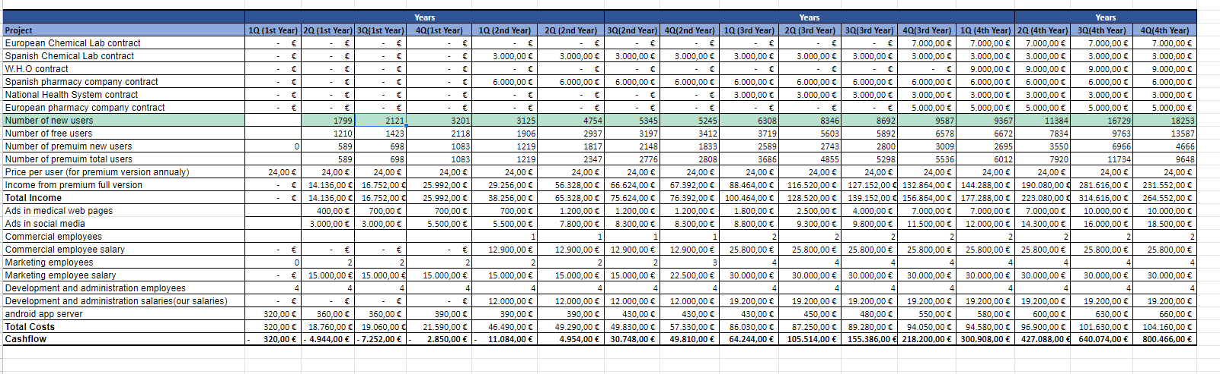
06. Financial Architecture Cash Flow
00 Team Members
01 Sprint Planning
02 Requirements
03 User cases & User stories
04 General Architecture
05 Database Model
06 financial Architecture

Slide 17
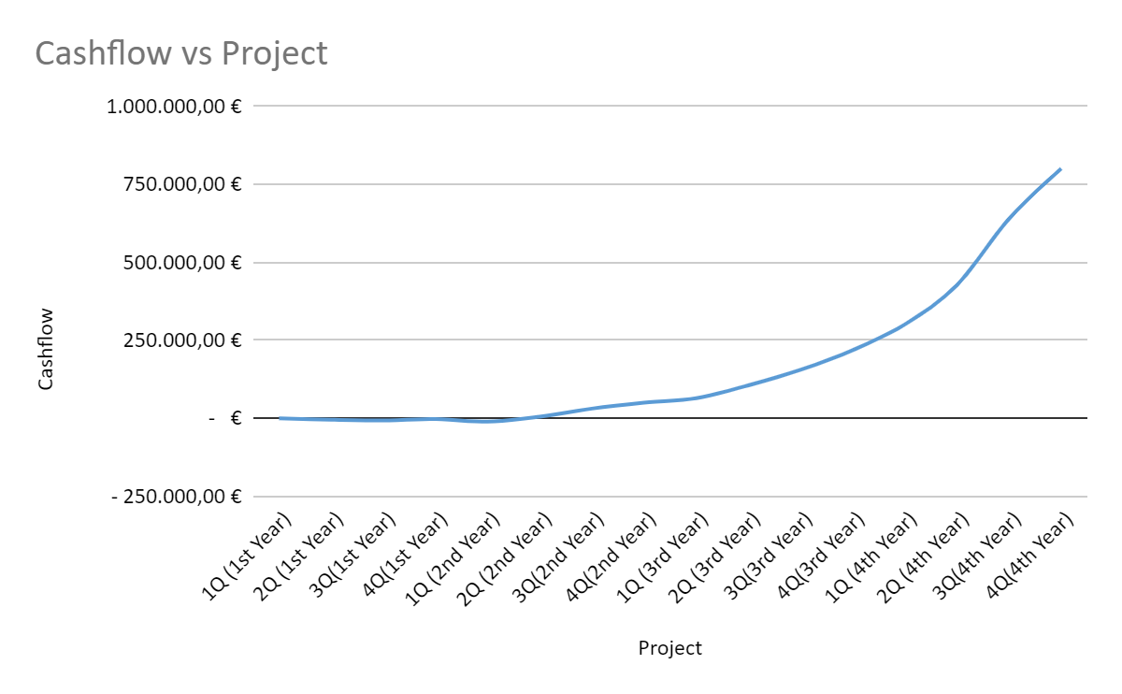
06. Financial Architecture Cash Flow
00 Team Members
01 Sprint Planning
02 Requirements
03 User cases & User stories
04 General Architecture
05 Database Model
06 financial Architecture

Slide 18
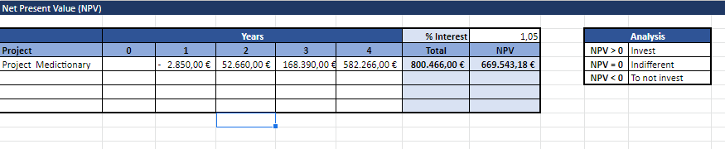
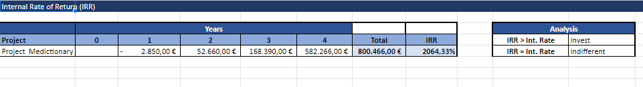
06. Financial Architecture NPV, IRR
00 Team Members
01 Sprint Planning
02 Requirements
03 User cases & User stories
04 General Architecture
05 Database Model
06 financial Architecture

Slide 19
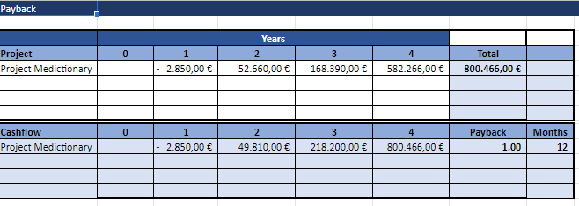
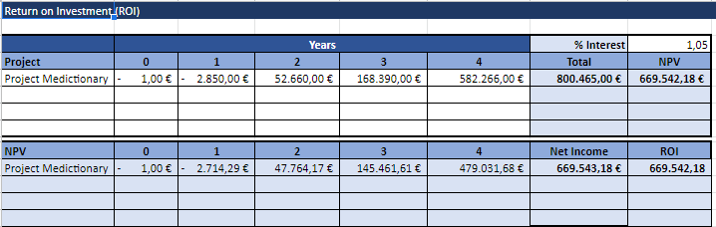
06. Financial Architecture Payback, ROI
00 Team Members
01 Sprint Planning
02 Requirements
03 User cases & User stories
04 General Architecture
05 Database Model
06 financial Architecture

Slide 20
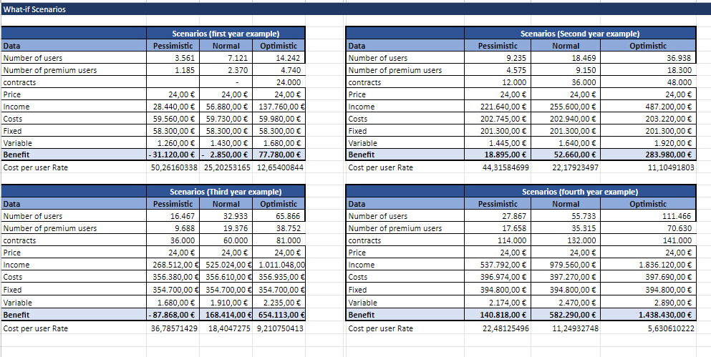
06. Financial Architecture What –if Scenarios
00 Team Members
01 Sprint Planning
02 Requirements
03 User cases & User stories
04 General Architecture
05 Database Model
06 financial Architecture

Slide 21
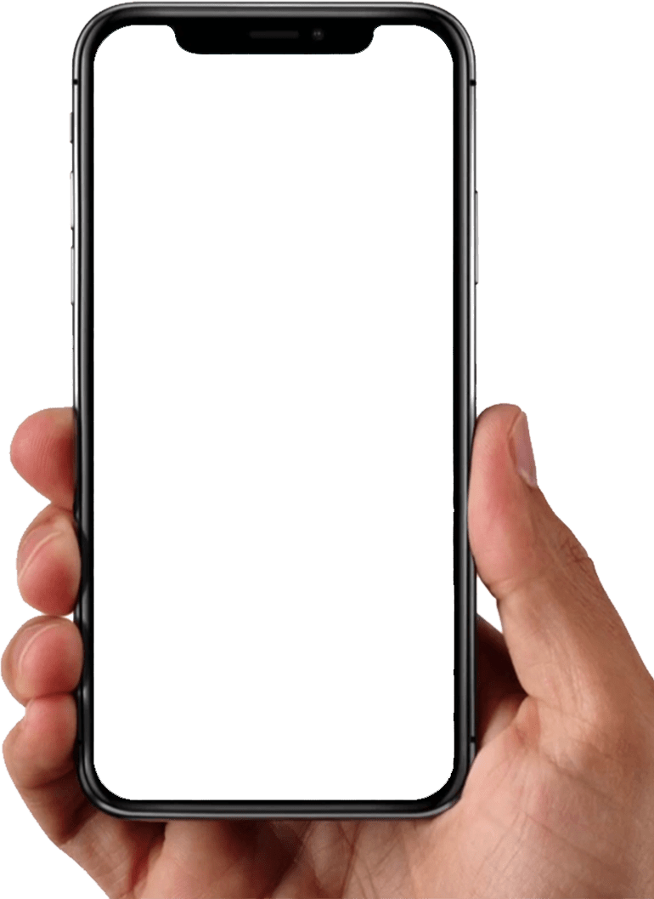
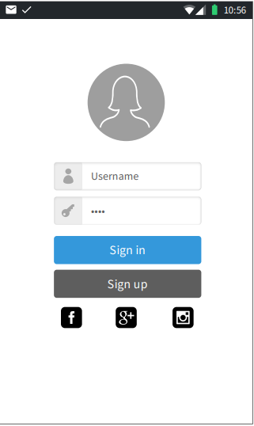
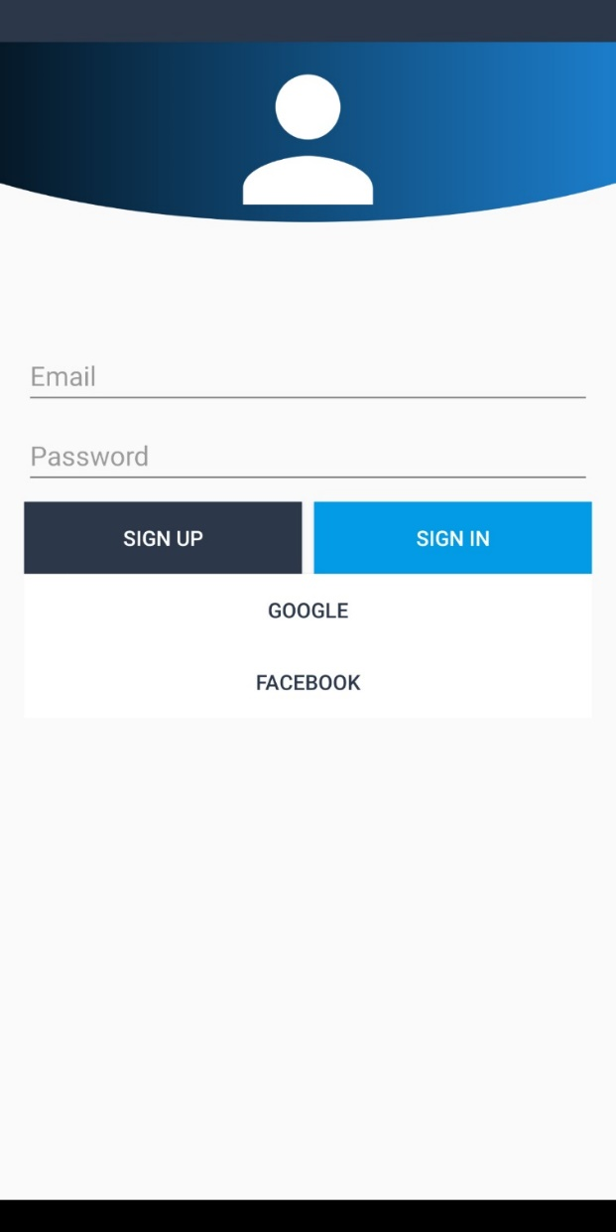
07. Mockup & Prototype App
Function 0 : Sign up, Sign in
Basically, User can join the application with Username (email) and password
Also, User can use the google or facebook account for sign up , sign in
00 Team Members
01 Sprint Planning
02 Requirements
03 User cases & User stories
04 General Architecture
05 Database Model
06 financial Architecture
07 Mockup & prototype

Slide 22
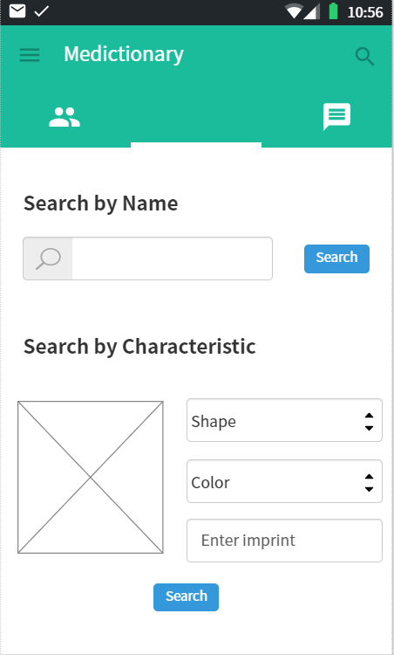
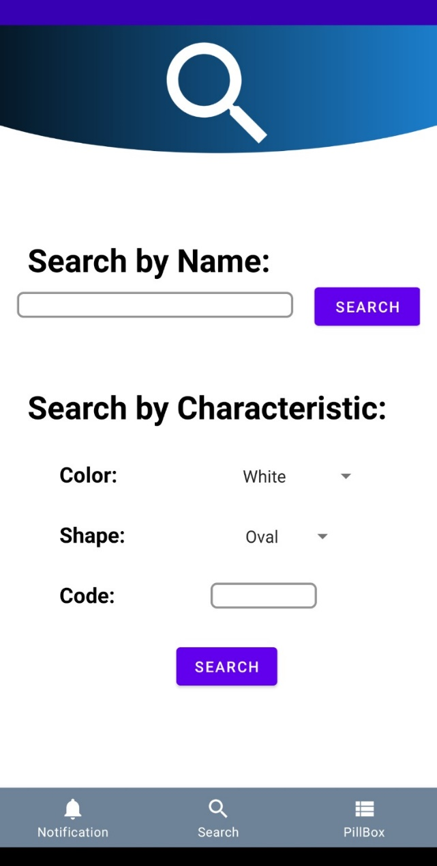
07. Mockup & Prototype App
Function 1 : Searching
User can search the pill with name or characteristic
When the user doesn’t know about the name, they can find the pill with the color, shape, imprint
00 Team Members
01 Sprint Planning
02 Requirements
03 User cases & User stories
04 General Architecture
05 Database Model
06 financial Architecture
07 Mockup & prototype

Slide 23
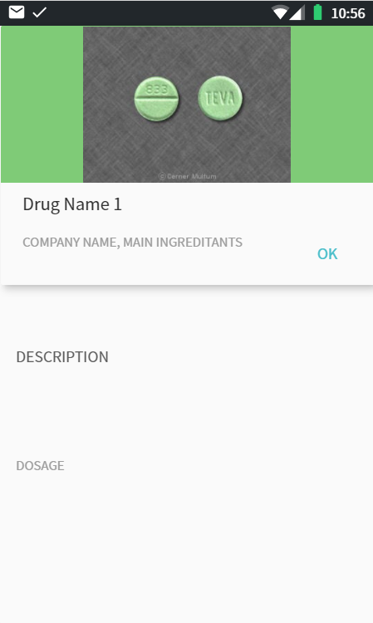
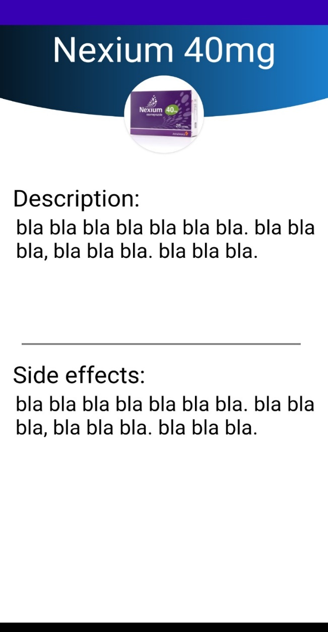
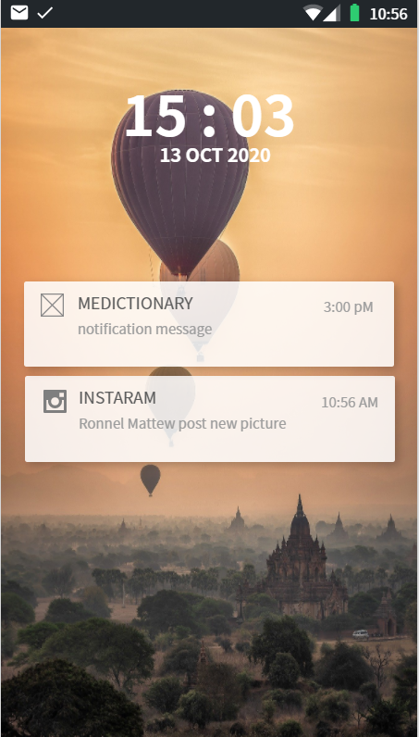
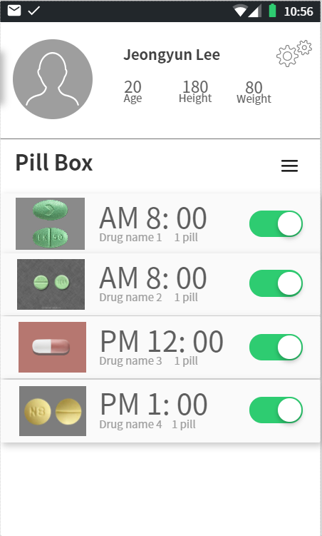
07. Mockup & Prototype App
Function 1 : Searching
The user can see the detailed information like the name of pills, description and side effects of pills.
00 Team Members
01 Sprint Planning
02 Requirements
03 User cases & User stories
04 General Architecture
05 Database Model
06 financial Architecture
07 Mockup & prototype

Slide 24
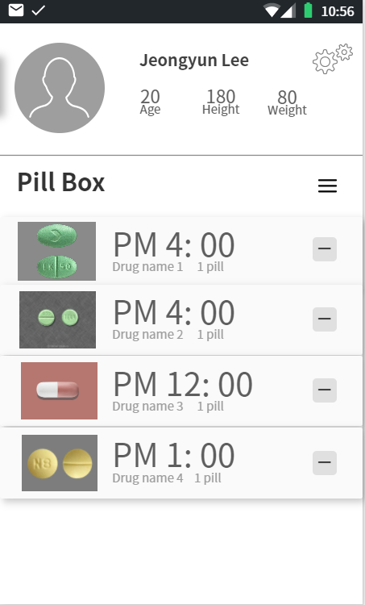
07. Mockup & Prototype App
Function 2 : Setting Alarm
The users can check the pills they are taking. Moreover, they can set alarm in this pill box page.
The pill box can be modified with the button next to the pill box. They can remove the pill which they don’t want to take anymore.
00 Team Members
01 Sprint Planning
02 Requirements
03 User cases & User stories
04 General Architecture
05 Database Model
06 financial Architecture
07 Mockup & prototype

Slide 25
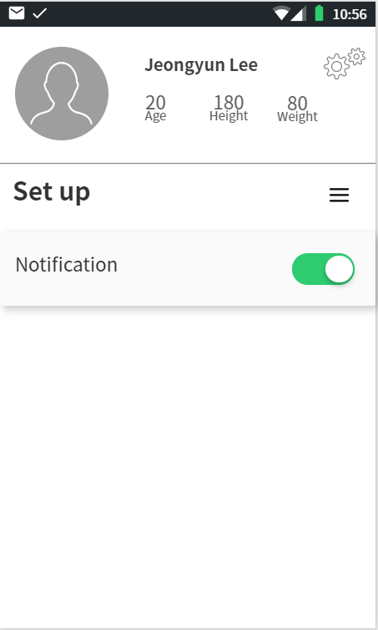
07. Mockup & Prototype App
Function 3 : Notification
The user can decide whether they would get the notification on setting page.
The user would be waned about their diet or when they have the pills with conflicted ingredients.
00 Team Members
01 Sprint Planning
02 Requirements
03 User cases & User stories
04 General Architecture
05 Database Model
06 financial Architecture
07 Mockup & prototype

Slide 26

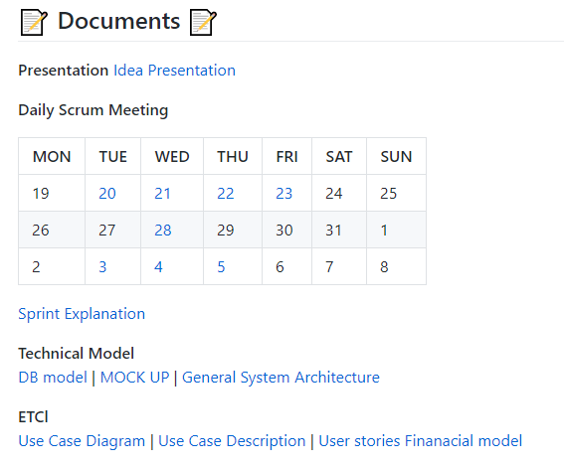
Moreover
If you want to see more details..

Slide 27
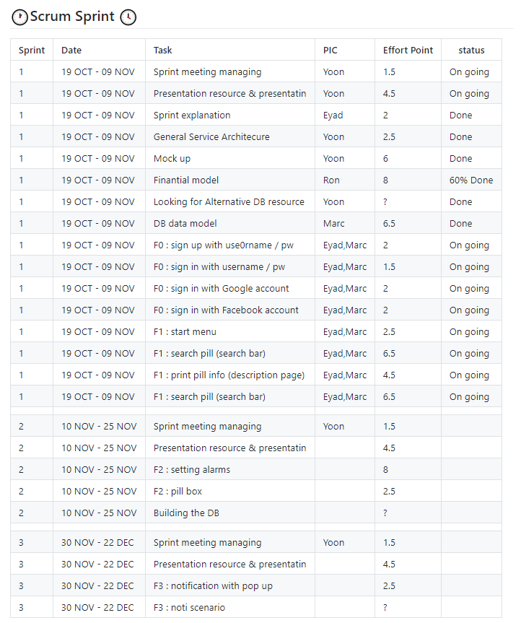
Moreover
If you want to see more details..

Slide 28
Q & A
Github
https://github.com/jy-977/ICT-medictionary
Jeongyun Lee
https://github.com/jy-977
Marc Visa
https://github.com/mvp17
Ronnel Mattew
https://github.com/ron7858
Eyad Al Hafi
https://github.com/eyadfhafi

Slide 29
Thank you for watching
Github
https://github.com/jy-977/ICT-medictionary
Jeongyun Lee
https://github.com/jy-977
Marc Visa
https://github.com/mvp17
Ronnel Mattew
https://github.com/ron7858
Eyad Al Hafi
https://github.com/eyadfhafi

